Slide 1
Finding Stories in Data
Where to Begin?

Slide 2
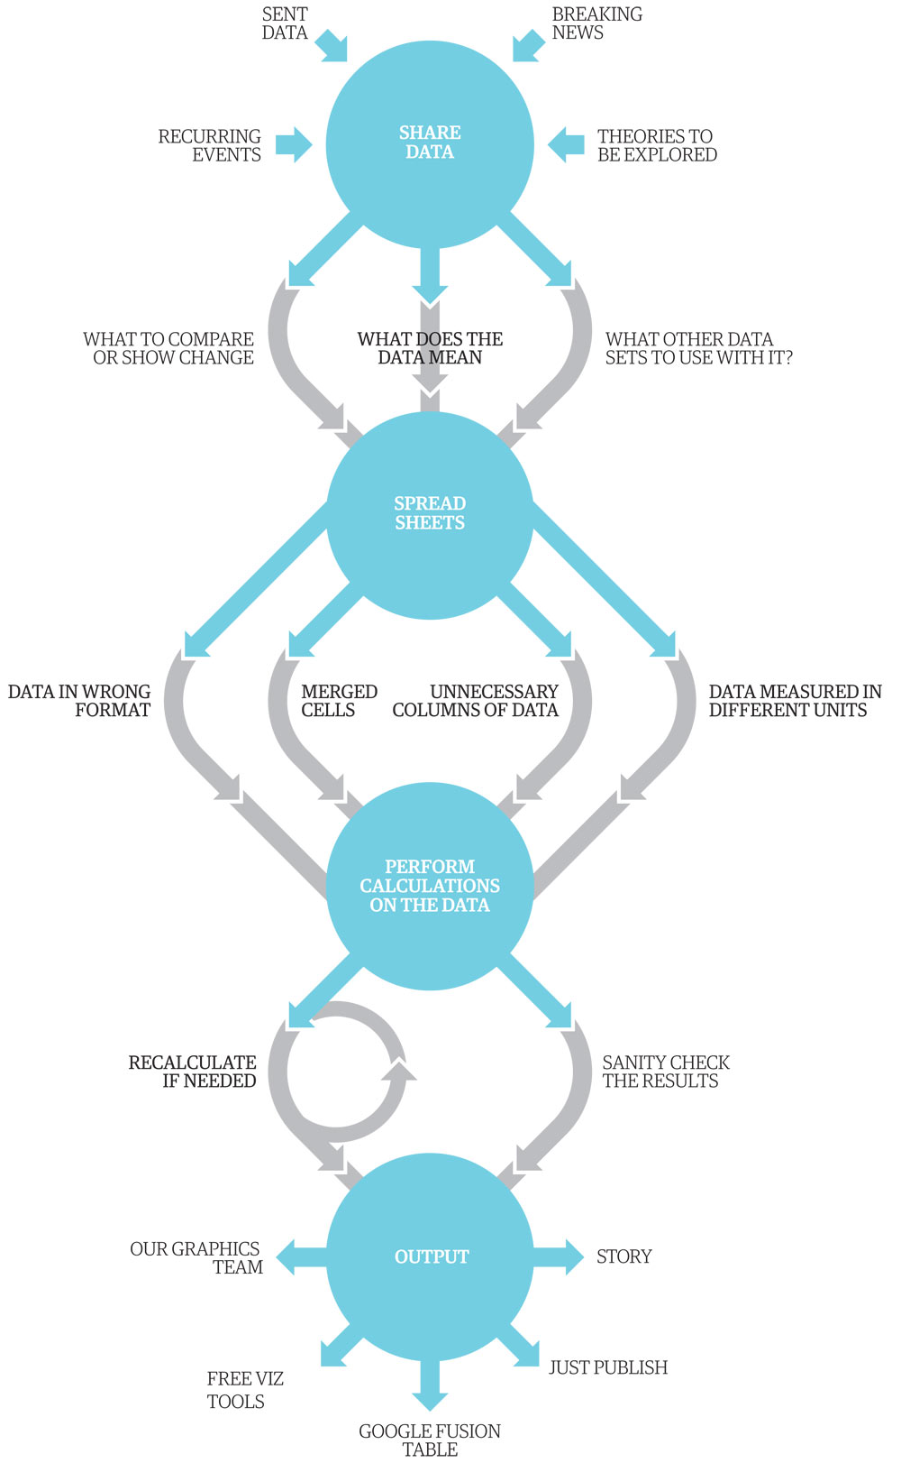
www.theguardian.com

Slide 3
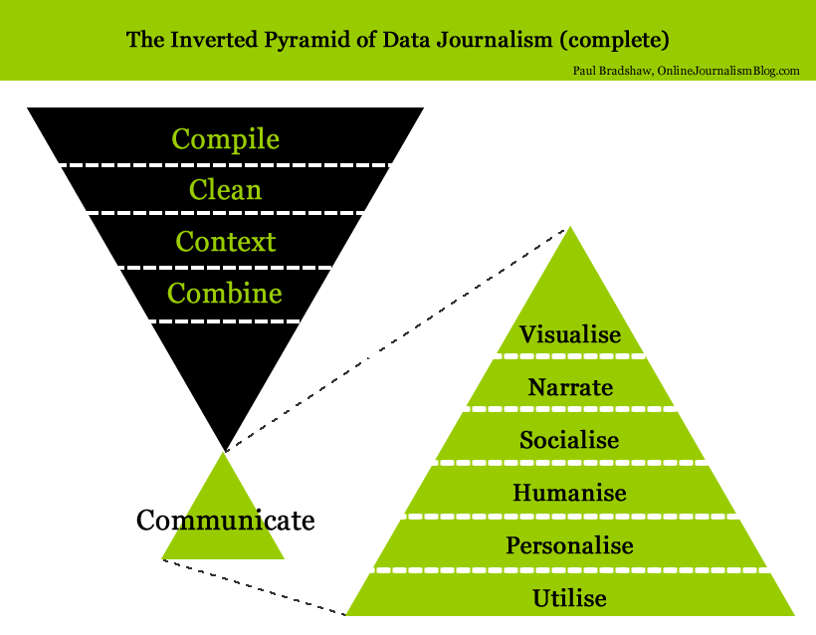

Slide 4
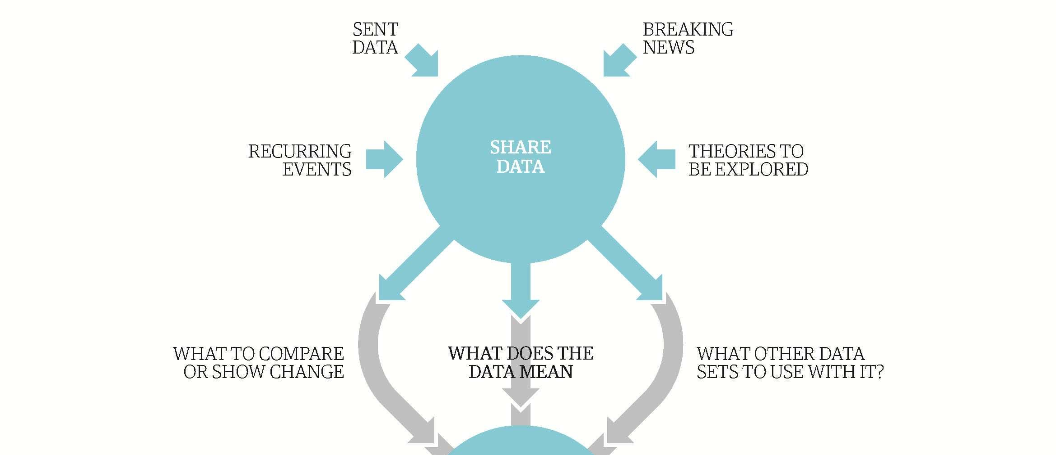
Sources of data story ideas

Slide 5
Recurring Events: data releases
Government Reports: Down the Drain: India’s Costly Irrigation Battle
Consumer Reports: Bacteria on Chicken Breasts
Deforestation reports: InfoAmazonia Deforestation Map
Crime statistics: Oman’s first release of crime data: Crime in Oman Visualized
Argentina Census: Census Project Argentina

Slide 6
Brainstorm: What is the news hook for food safety or the environment?
Daily air quality reports?
Water quality studies?
Draught and food security research?
Demographic information?
Government budgetary reports?
Agricultural research?
What other kinds of press releases to you receive related to data? What is the news angle for digging into the data?

Slide 7
Sent data … sometimes you get lucky!
Offshore Leaks: A leaked hard drive of 2.5 million documents about offshore bank accounts to the International Consortium of Investigative Journalists
Investigative Dashboard: Lists of international business databases.
Both databases are now public: open data push extends to leaked data

Slide 8
Breaking News
Data collection:
Crowd-sourcing via Ushahidi-type platforms
Citizen media contributions
Sensor data for environmental catstrophes
Risks:
Selection bias
Verification process
Context

Slide 9
Breaking news: data enriches story
Mother Jones: What you Need to Know about the Horn of Africa Famine
Infoamazonia: Hydroelectrics of Tapajos in a map, numbers and graphs
ABC Austrailia: The Coal Seam Gas Rush

Slide 10
Exercise: What Data is Missing?
Choose a recent water story:
Pollution Threatens China’s Ambitious Water-Transfer Project
Inside China’s Desperate Effort To Control Pollution — Before It’s Too Late
China's South-North Water Diversion Project Starts To Supply Water

Slide 11
Exercise: What Data is Missing?
Write down the author’s hypothesis
List the data that the author used to prove or disprove the hypothesis
Write down a deeper hypothesis that would either put the problem in context, explore contributing factors or quantify impact
List the questions that your story with richer data would answer

Slide 12
Theories to be explored: databases
World Bank Data
United Nations Data
World Research Institute
World Health Organization Data
World Bank Food Safety Data
Open Data Catalogue
UNEP Data
Transparency International Corruption Index
Land Ownership Database
Gapminder World

Slide 13
Finding Data on the Web

Slide 14
Data formats for download
Portable Document Format (PDF): charts that contain data but are saved in a unified document with text
Excel file (xls): data is saved as a table readable by Microsoft Excel
Comma separated values (CSV): Plain text file with each data separated by a comma

Slide 15
Advanced Google Searches
Type OR to find variations of the same search: China “pollution” OR “air quality” OR “contamination”
Use quotes to search for phrases
Narrow search to specific website: “site:url” Example “site:http://www.chinadaily.com.cn/ environment”
Narrow search to filetype: “Filetype:[extension]” Example: “site:fao.org china filetype:pdf”
Google alerts: get notified about your beat

Slide 16
Data sources online
Advanced search techniques to find data in the deep web
Scraping databases in html format using tools like Import.io
Converting documents like PDFs into a more useable format
Pulling information from Application Programming Interfaces (APIs), which automatically updates a database with new data pulled from the web

Slide 17
Exercise: Finding Water Data
Return to:
Pollution Threatens China’s Ambitious Water-Transfer Project
Inside China’s Desperate Effort To Control Pollution — Before It’s Too Late
China's South-North Water Diversion Project Starts To Supply Water
Find data to enrich the stories and proves or disproves your hypothesis.

